Slide 1
Frequency Stabilization with Hollow Cathode Lamp.pptx
Li He
December 13th
2017

Slide 2
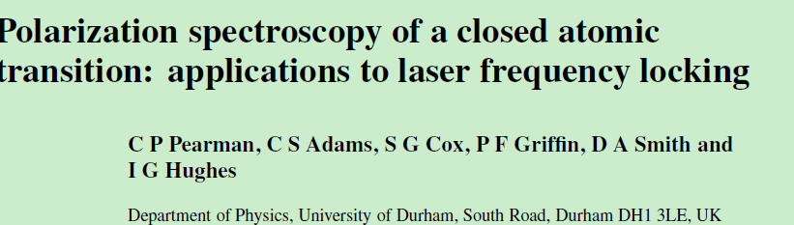
Why stabilize laser frequency
What is Hollow Cathode Lamp (HCL)
What is polarization spectroscopy
How do stabilization with HCL

Slide 3
Why stabilize laser frequency
Yb 171 Doppler cooling using transition between ²S_{1/2} and ²P_{1/2} corresponding to 369nm laser
Photo diode laser frequency is not stable (100MHz ) due to the temperature distortion and aging problem of cavity inside the laser is.
So we need a stable reference to give feedback to the laser

Slide 4
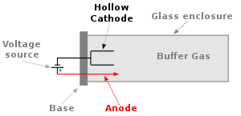
What is Hollow Cathode Lamp (HCL)
Buffer gas has the Yb atom
A large voltage across the anode and cathode will cause the buffer gas to ionize, creating a plasma
Then there are Yb+ ions in it

Slide 5
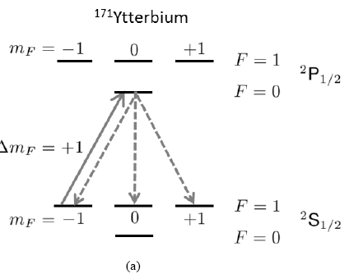
What is polarization spectroscopy
Selection rules: ∆m_{F}=±1,0
-1 →0, absorb σ+
+1 →0, absorb σ-
At thermal equilibrium , the distribution between -1 and +1 are same, so the absorption of σ+ and σ- are the same.
If the distribution is changed, the absorption will change. Then We will see the intensity difference between of σ+ and σ-
The distribution is changed by pumping from -1 to 0 with σ+, spontaneous radiation to -1，0，+1 with the same probability. So -1 is depleted.
This phenomenon is strong when resonant

Slide 6
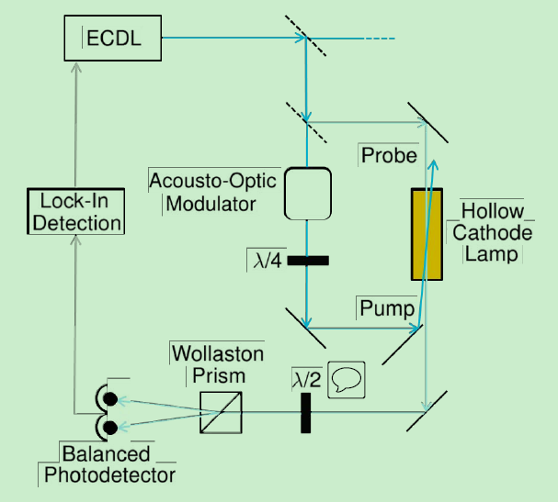
Set up
Pump : deplete the m_{F}-1
Probe : linear polarization can be decomposed to σ+ and σ-
Wollaston prism can split the horizontal and vertical linear polarization
Balanced photo detector (BPD) gives the differential signal
To trapped ion
σ+

Slide 7
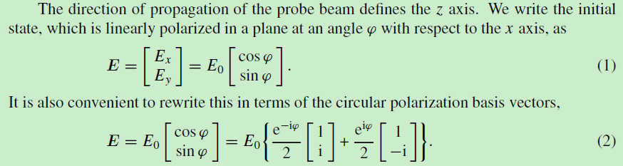
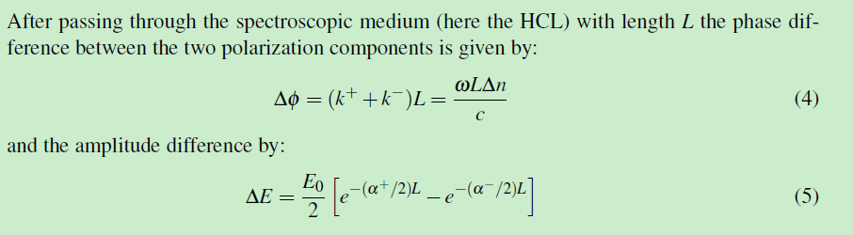
Theory

Slide 8
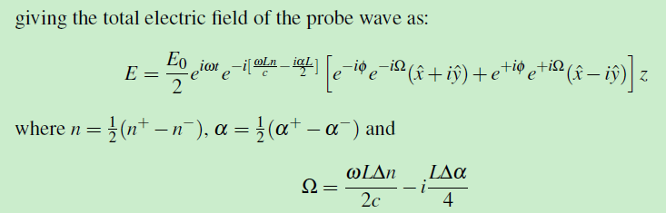


Slide 9
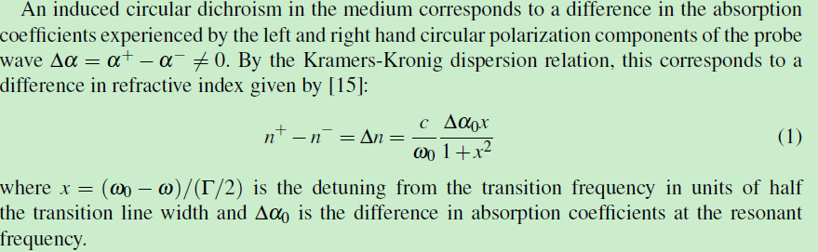
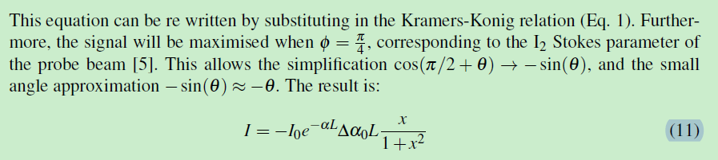

Slide 10
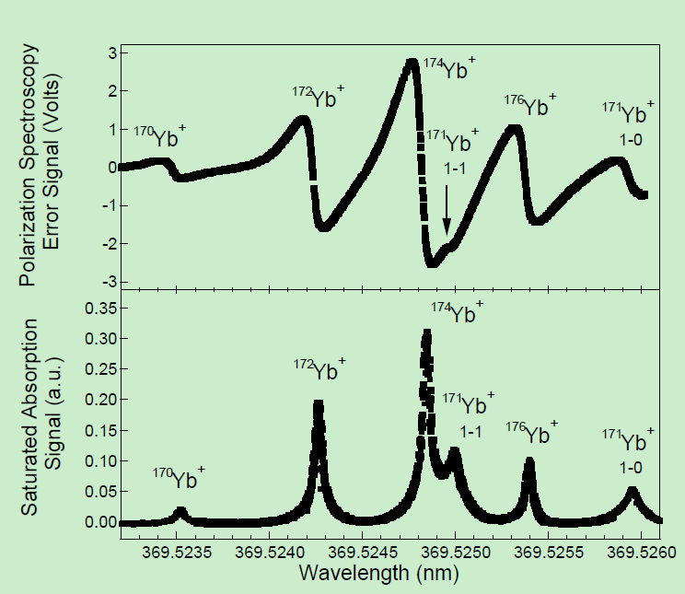
Error signal
advantage of polarization spectroscopy
100MHz capture
Standard Deviation 400kHz
0 point not shift with magnetic field

Slide 11
Question
Why not shift with magnetic field

